Slide 1
AUTOMATIC ACCIDENT ALERT SYSTEM
TEAM: MIND CRUSADERS
TEAM MEMBERS:
ANUSHKA XAVIER K
DONA DAVIS
VAISHNA S

Slide 2
EXISTING SYSTEM
In the existing system, Arduino is used for controlling whole the process with a GPS Receiver and GSM module. GPS Receiver is used for detecting coordinates of the vehicle, GSM module is used for sending the alert SMS with the coordinates and the link to Google Map. Accelerometer namely ADXL335 is used for detecting accident or sudden change in any axis..

Slide 3
PROPOSED SYSTEM
Automatic Vehicle Accident Alert System, an alerting message which contains accident’s time and location sent automatically by the particular device embedded in a vehicle to emergency and relief agencies. So, they can rush to the accident and help the victim in time. The required parameters and the sensor values are sent to the Dynamo DB through mobile application. The data is stored in the IBM cloud platform. To detect the accidents accelerometer sensor is used so when accident is detected we can retrieve the location from the mobile app and send notifications to nearest hospitals from the mobile app and can intimate family members.

Slide 4
SOFTWARES
Arduino IDE
MIT App Inventor
MSG 91

Slide 5
HARDWARE
Arduino NANO
Accelerometer ADXL335
HC-05 Bluetooth module

Slide 6
ARDUINO UNO
The Arduino UNO is a widely used open-source microcontroller board based on the ATmega328P microcontroller and developed by Arduino.cc. The arduino is the major control unit to detect or alert when an accident occurs. It collects the data from vibration sensor, and reflects the output either in display system or through a message. Here vibration sensor plays a major role. This vibration sensor will receive the vibrations of the vehicle which in turn acts as a accident detection module. Arduino gathers the information from all other modules and sends the message to the receiver

Slide 7
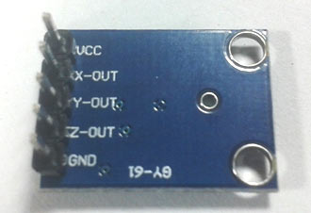
ACCELEROMETER
An Accelerometer is added in this system for detecting an accident and its x,y, and z-axis ADC output pins are directly connected to Arduino ADC pin A1, A2, and

Slide 8
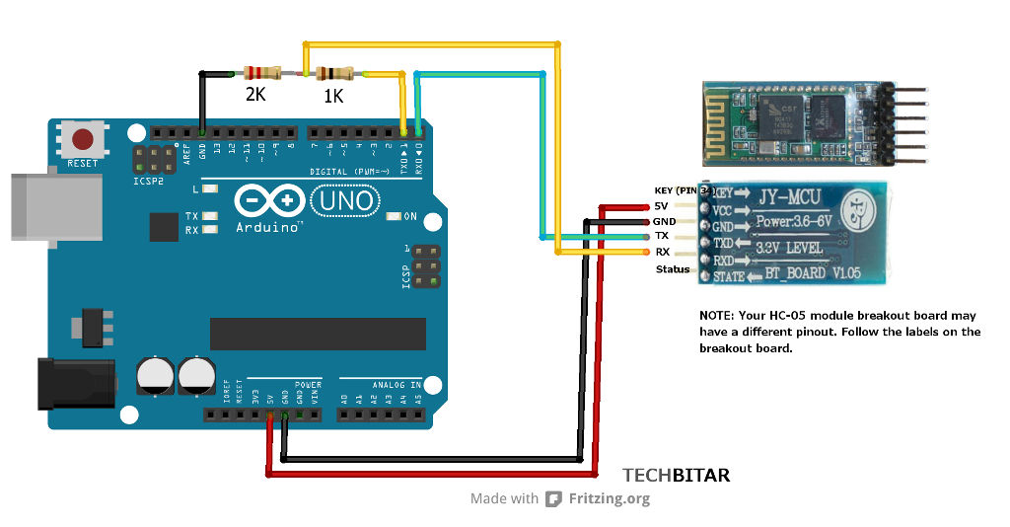
HC-05 Bluetooth Module
the HC-05 Bluetooth module and make a Bluetooth communication between the mobile app and the device. tItcommunicates with the Arduino via the Serial Communication.

Slide 9
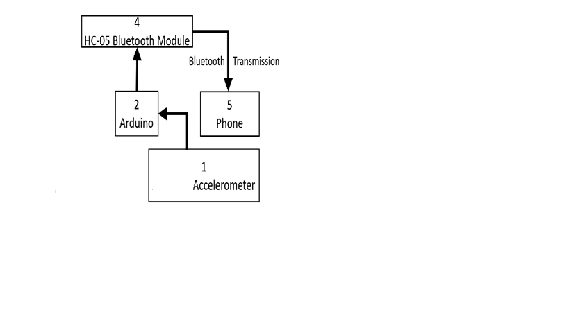
ARCHITECTURE

Slide 10
WORKING
Accelerometer senses the change values of the coordinates of the vehicle (x , y , z) and send the data to mobile app check the intensity of the accident via Bluetooth module. The mobile app detects the occurrence of the accident and send the time and precise location of accident to the nearby medical centers or the ambulance drivers through SMS and thus save the victims.

Slide 11
DISADVANTAGES OF EXISTING SYSTEM
Injury or loss of life.
Property damage
Traffic congestion for everyone.
Rising insurance premiums.

Slide 12
ADVANTAGES
Low cost
Portability
Small size
Locate the site of accident accurately
Decreases the chance of casualties

Slide 13
THANK YOU

